Slide 1
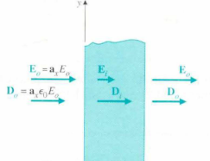
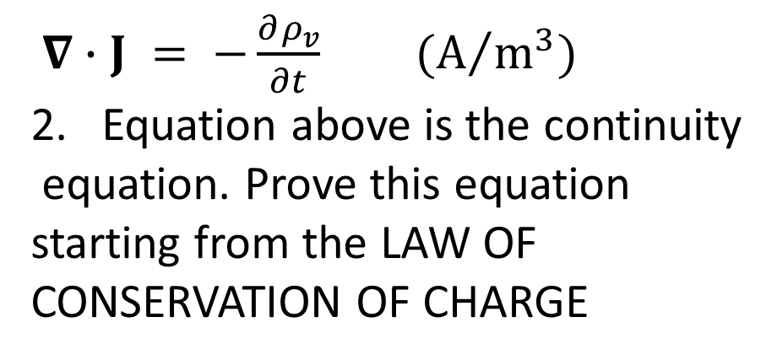
DEADLINE – 20th JUNE 2020
Find the Ei, Di, Eo, Do and Po in Figure 1
$∇∙J = −\frac{∂ρ_{v}}{∂t} (A/{m^{3}})$
Equation above is the continuity
equation. Prove this equation
starting from the LAW OF
CONSERVATION OF CHARGE
Po
Pi
Po
εr = 4.4
Free space
Free space
Figure 1

Slide 2
There is no existence of a magnetic charge. Explain?
Explain two ways a magnetic field can be produced?
Briefly explain Electrostatics. Express the fundamental postulates (law) for electrostatics in free space. Express it in both differential and integral forms?
Write the expression for the law of conservation of magnetic Flux?
Express (in formula and in words) what happens when free static electric charges are inserted inside a conductor?
Express what happens to the Electric field at a boundary between free-space and conductor (in formula and in words)?

